Slide 1

Theory of Computation
01

Slide 2
Info
Submitted to | Dr. Fernaz Narin Nur
Submitted by | Shazidul Alam, Anisur Rahman Naeem
ID | 0692220005101009, 0692220005101015
Batch | CSE 19
Subject | Theory of Computation (CSE 2207)
Topic | DFA and Traffic Control System
02

Slide 3
Table of contents
01
02
03
04
Introduction to DFA
Practical usage of DFA
Traffic control system in DFA
Conclusion
03

Slide 4
What is DFA ?
A DFA, or Deterministic Finite Automaton, is a mathematical model consisting of states, transitions, and input symbols where each input symbol leads to a unique next state, used to recognize patterns and sequences in computer science and automata theory.
04

Slide 5
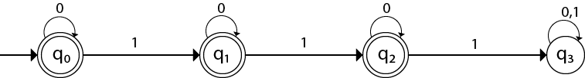

Example of DFA
Here’s a simple example of DFA.
Where, Q = {${ q}_{0}$, $q_{1}$, $q_{2}$, $q_{3 }$}
$Σ$ = { 0, 1 }
05

Slide 6
Some practical usage of DFA
Automated Manufacturing
Traffic light controllers
Elevator Control
Vending Machines
Automatic Doors
Thermostat Control
Robotics
06

Slide 7
Explanation of an Usage
Traffic control system in DFA
1. A traffic light control DFA is a deterministic finite automaton that models and controls the behavior of a traffic light system.
2. The DFA has a finite number of states, each of which represents a different phase of the traffic light cycle.
3. The DFA transitions from one state to another based on the current state and the input signals from sensors.
07

Slide 8
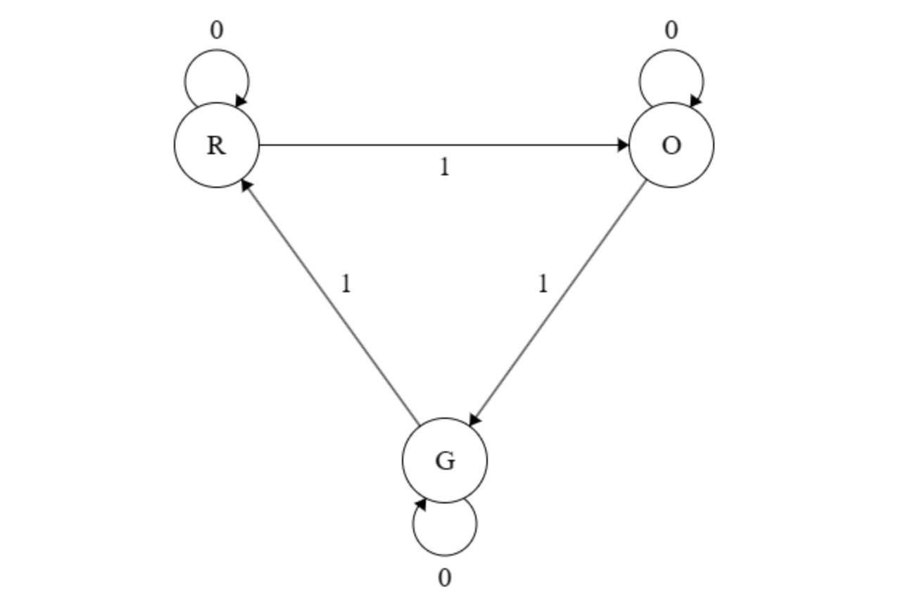
DFA of Traffic Control System
R=Red
O=Orange
G=Green
08

Slide 9
Deep Analysis 1st Part
States: In a traffic light control DFA, the states represent the different configurations of the traffic lights at an intersection. These states typically include various possible combinations of green, yellow, and red lights.
Transitions: Transitions between states are triggered by a combination of factors, including timer intervals. For example, when the timer for the green light in one direction expires, the DFA transitions to the state representing the yellow light for that direction. Similarly, when sensors detect vehicles waiting at a red light, this can trigger a transition to a green light state so that vehicles can move.
09

Slide 10
Deep Analysis 2nd Part
3) Inputs: Inputs to the DFA can include sensor data from cameras, pressure plates, or other detectors that detect the presence of vehicles waiting at the intersection. Inputs can also include the timing information for the traffic lights, such as the duration of green and yellow lights.
4) Outputs: Outputs in a traffic light control DFA correspond to the actual lighting of the traffic signals. These outputs determine which lights are illuminated for each direction of traffic, such as green for "Go," yellow for "Prepare to Stop," and red for "Stop."
10

Slide 11
Conclusion
In conclusion, the Theory of Computation is a fascinating and essential field in computer science that has profoundly impacted our understanding of what can be computed.
It has provided the theoretical foundation for designing efficient algorithms, developing programming languages, and advancing the field of artificial intelligence.
With its rich history and ongoing contributions, the Theory of Computation continues to inspire innovation and drive progress in the world of computing, opening doors to new frontiers in technology and problem-solving.
11

Slide 12
Thanks
12

